Slide 2
Windows Azure Pack Roadmap
BRK2451
Robert Reynolds

Slide 3
Microsoft Cloud Platform Journey
Customer
Microsoft Azure Stack
ONE
Windows Azure Pack
Consistency
Consistent Platform
Service Providers
Windows Server vNext
Microsoft
UR releases
Time
Our goals remain the same
Azure for your datacenter
Enable consistent development and operations
Enable a hybrid ecosystem

Slide 4
Windows Azure Pack

Slide 5




Windows Azure Pack Overview
Services
Plans
Users
Automation
Admin Site
Web Sites
Apps
Database
VMs
Tenant Site
Self-service based on Microsoft Azure
Multi-tenant IaaS and PaaS
Service Management API
Usage tracking
Web
Sites
VMs,
Networks,
Automation
Database
SQL Sever MySQL
Service
Bus
Custom Resource
Providers
Automation
w/ Service Provider Foundation
& Service Management Automation
Offer management
Portal integration and branding

Slide 6
Windows Azure Pack Update Releases
2014
2015
2016
2014
Feb
Mar
Apr
May
Jun
Jul
Aug
Sep
Oct
Nov
Dec
Jan
Feb
Mar
Apr
May
Jun
Jul
Aug
Sep
Oct
Nov
Dec
Jan
Feb
Mar
Apr
2016
Jan
Apr
Jul
Oct
Jan
Apr
Jul
Oct
Jan
Apr
UPDATE
1
UPDATE
2
UPDATE
3
UPDATE
4
UPDATE
5
UPDATE
6
UPDATE
7
UPDATE
8
UPDATE
9
UPDATE
10
Update Release 1
Update Release 2
Update Release 3
Update Release 4
Update Release 5
Update Release 6

Slide 7
Key enhancements in Update Releases
IaaS (VMs and Networking)
UR2: Dynamic Memory support
UR3: Multiple NIC support
UR4: Azure Site Recovery integration
UR5: Support for dedicated disks with VM Roles
UR6: VM Checkpoint and Restore, Gen2 VM Roles
DBaaS (SQL Server)
UR3: WinAuth support
UR5: Performance isolation using SQL Server 2014 Resource Governor
WebSites
UR2: WinAuth support
UR3: PHP5.5, Classic ASP.NET support
UR6: WebJobs, Deployment Slots for staging

Slide 8
VM Checkpointing in UR6

Slide 9
Windows Azure Pack Futures
Update Release priorities driven by customer and partner feedback
Continued support for new releases of System Center and Windows Server
Mainstream support through 2017 with extended support through 2022
Feature backlog tentatively targeted for UR7 and beyond
Security Group ACLs on offered Plans
Quantity based quotas for checkpoints
Multiple public IP support on tenant virtual networks
DR and backup as options during VM creation
VM template-defined Admin Credentials as alternative to tenant-defined

Slide 10









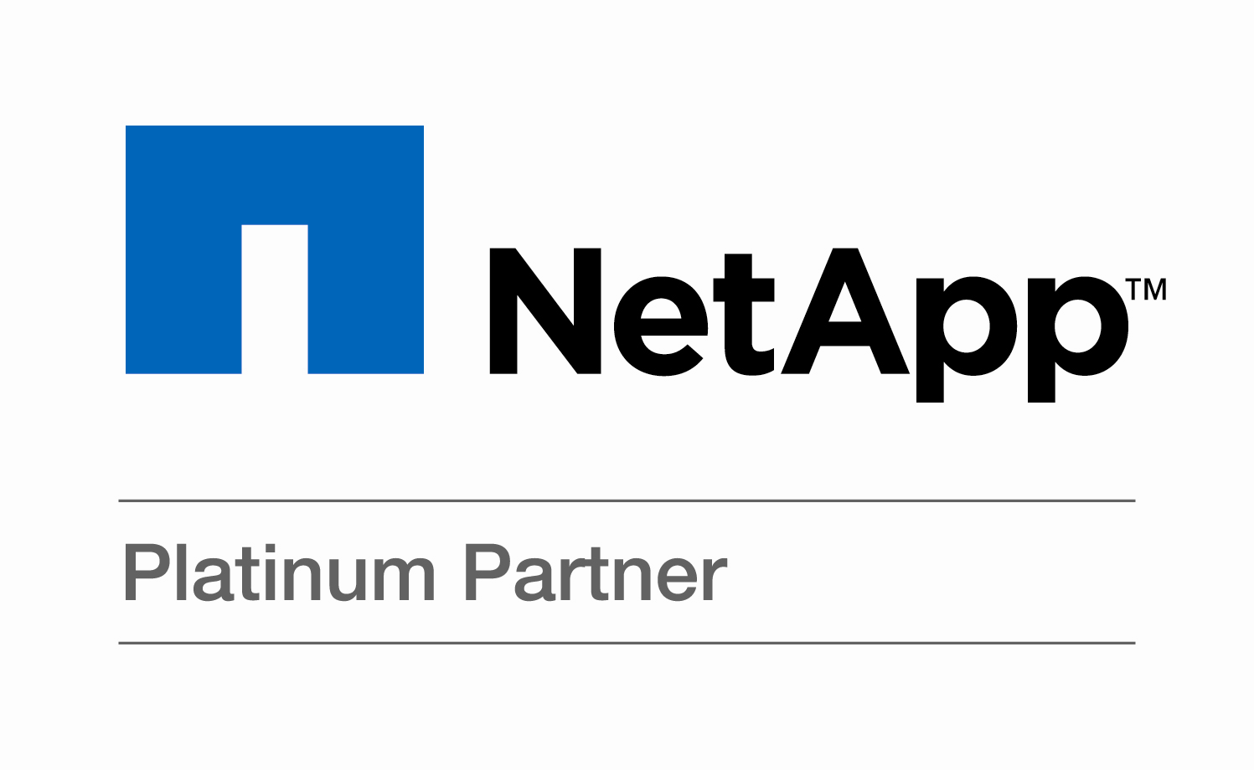








Partner Solutions for Windows Azure Pack
Gallery Content
Integration
Resource Providers
Infrastructure
In Market
More Info Expanding Microsoft Cloud Platform with WAP and Partners Today 1:30-2:45pm in E351
In Preview
In Development

Slide 11
Microsoft Azure Stack (formerly known as WAP vNext)
Bringing more Azure to your datacenter

Slide 12
What is new in Microsoft Azure Stack
Browser Experience
New product for your datacenter
Cloud-optimized application platform
Azure-based Compute, Network, and Storage services
Cloud-consistent service delivery
Portal enables integrated Admin/Tenant experiences
Resource Manager is the new Service Management API
Updated core management services
Cloud-inspired infrastructure
Windows Server-based compute, network, and storage
User Facing Services
HUBS
Portal Shell Site
RP Admin Extension
RP Tenant Extension
Resource Manager
Core Management Resource Providers
Authorization
Subscriptions
Gallery
Events
Monitoring
Usage
Service Resource Providers
Compute
Network
Storage
…..
Compute Fabric
Network Fabric
Storage Fabric

Slide 13
Azure Stack Resource Manager
Azure consistent management API
Normalized resource access
Role-based access control
Declarative service templates
Resource Groups
Resource tagging
Multi-region services
Audit logging
Azure Resource Manager API

Slide 14
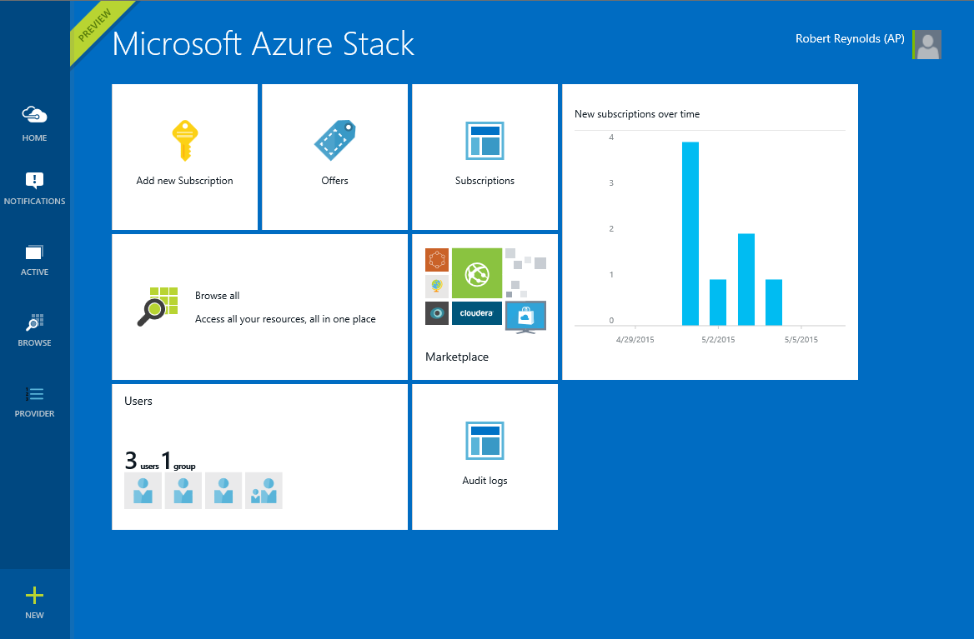
Azure Stack Portal
Azure consistent user experience
Beautiful
Rich personalization
Highly Scalable UX
Integration across services
3rd-party extensibility model
Integrated Admin/Tenant

Slide 15
Azure Stack identity
Identity
System
Native support for Azure AD, Windows AD, ADFS
Claims-based identity used from clients to ARM API
Windows Auth or basic auth from ARM to Resource Providers
Resource Providers to resources Windows Auth or determined by RP
Browser Experience
User Facing Services
HUBS
Portal Shell Site
RP Admin Extension
RP Tenant Extension
Resource Manager
Core Management Resource Providers
Authorization
Subscriptions
Gallery
Events
Monitoring
Usage
Service Resource Providers
More Info Identity capabilities in Azure Pack Friday 10:45am-12:00pm in S505
Compute
Network
Storage
…..
Compute Fabric
Network Fabric
Storage Fabric

Slide 16
Azure Stack core management services
Browser Experience
Authorization
RBAC rules
Subscriptions
Plans, Offers, Subscriptions
Gallery
Gallery items for any service
Events
Events from all services
Monitoring
Metrics from all services
Usage
Normalized usage data from all services
User Facing Services
HUBS
Portal Shell Site
RP Admin Extension
RP Tenant Extension
Resource Manager
Core Management Resource Providers
Authorization
Subscriptions
Gallery
Events
Monitoring
Usage
Service Resource Providers
Compute
Network
Storage
…..
Compute Fabric
Network Fabric
Storage Fabric

Slide 17
Azure Stack Portal

Slide 18
Azure Stack Plans, Offers, and Subscriptions
PLAN
10 DBs
Base
OFFER
SQL
RP
10
Tenant
Provider
PLAN
5 DBs
Subscription
Add-On
1
Add-On
PLAN
1 DB

Slide 19
Azure Stack Plans & Offers

Slide 20
Microsoft Azure Stack You can start in the Azure portal today https://portal.azure.com
Bringing more Azure to your datacenter

Slide 21
Related Content: Breakout Sessions
Day | Timeslot | Title
Monday 5/4 | 3:15 – 4:30 | Platform Vision & Strategy: Azure Consistent Service Delivery Overview
Tuesday 5/5 | 5:00 – 6:15 | Provisioning SQL Database-as-a-Service in the Azure Pack
Wednesday 5/6 | 10:45 – 12:00 | Windows Azure Pack Roadmap
 | 1:30 – 2:45 | Expanding the Microsoft Cloud Platform with the Windows Azure Pack and Partners
 | 3:15-4:30 | Blobs and Tables: New Azure-consistent Storage for your Datacenter
Thursday 5/7 | 10:45 – 12:00 | Windows Azure Pack and Microsoft System Center: Monitoring and Requests for Service Providers
 | 1:30 – 2:45 | Azure IaaS for Azure Pack
 | 1:30 – 2:45 | Managing Linux Workloads in Windows Server, System Center and the Azure Pack
 | 3:15 – 4:30 | Troubleshooting Windows Azure Pack Providers
Friday 5/8 | 9:00 – 10:15 | Extending Virtual Machines in the Windows Azure Pack
 | 10:45 – 12:00 | Taking advantage of Identity capabilities in the Azure Pack

Slide 22
More information
Microsoft Azure Stack http://aka.ms/AzureStack
WAP Product Overview http://aka.ms/WAPoverview
WAP Customer Feedback http://aka.ms/WAPfeedback
WAP Partner Links http://aka.ms/WAPpartners
WAP Jump Start Session http://aka.ms/WAPjumpstart
Community Links on TechNet Wiki http://aka.ms/WAPwiki

Slide 23
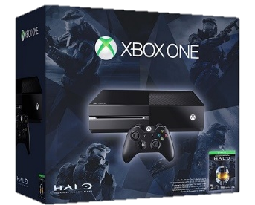
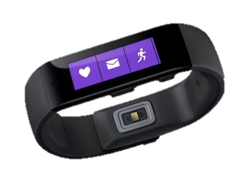
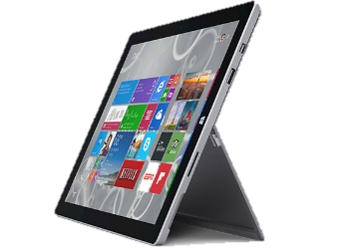

Ignite Azure Challenge Sweepstakes
Attend Azure sessions and activities, track your progress online, win raffle tickets for great prizes!
Aka.ms/MyAzureChallenge
Enter this session code online: BRK2451
NO PURCHASE NECESSARY. Open only to event attendees. Winners must be present to win. Game ends May 9th, 2015. For Official Rules, see The Cloud and Enterprise Lounge or myignite.com/challenge

Slide 24
Learn more with FREE IT Pro Resources
Free technical training resources:
On-demand online training: http://aka.ms/moderninfrastructure
Free ebooks:
Deploying Hyper-V with Software-Defined Storage & Networking: http://aka.ms/deployinghyperv
Microsoft System Center: Integrated Cloud Platform: http://aka.ms/cloud-platform-ebook
Expand your Modern Infrastructure Knowledge
Get hands-on: Free virtual labs:
Microsoft Virtualization with Windows Server and System Center: http://aka.ms/virtualization-lab
Windows Azure Pack: Install and Configure: http://aka.ms/wap-lab
Join the IT Pro community:
Twitter @MS_ITPro

Slide 25
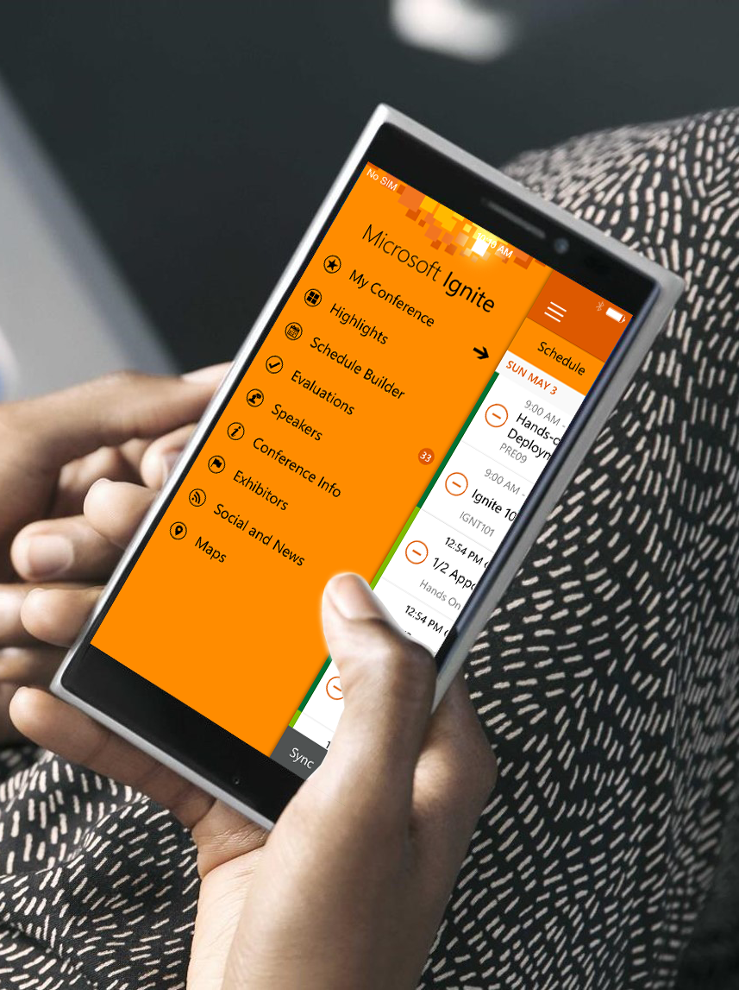
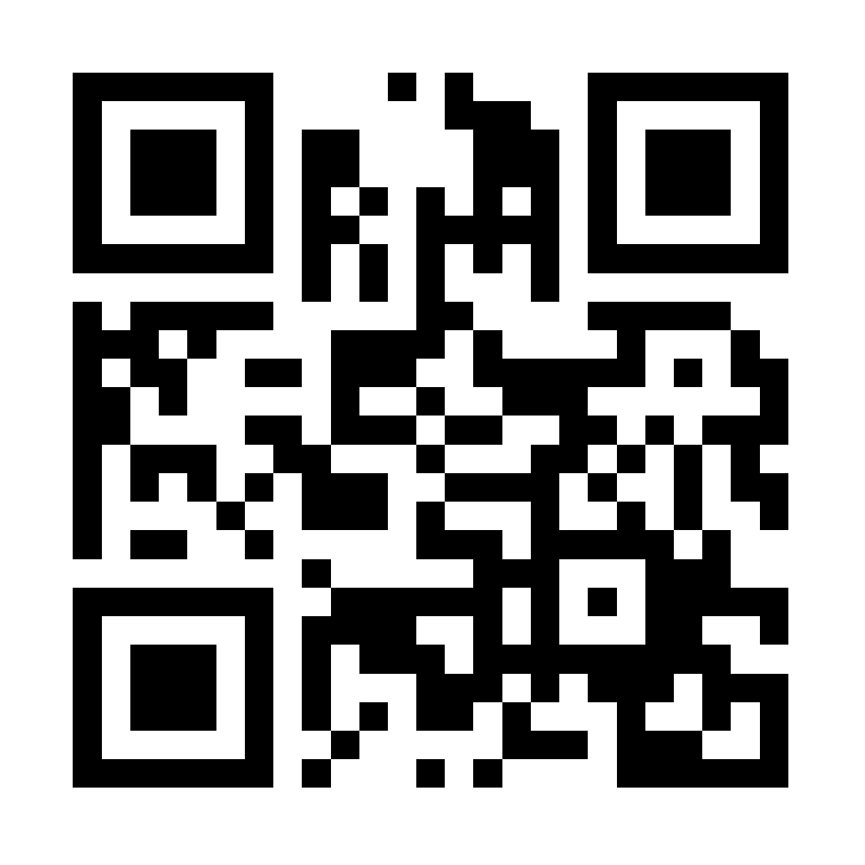
Please evaluate this session
Your feedback is important to us!
Visit Myignite at http://myignite.microsoft.com or download and use the Ignite Mobile App with the QR code above.

